Slide 1

The post-phd job hunt
November 19, 2025
Megan Austin-Cherry, Ph.D.
Rachel Davis, Ph.D.
Amanda Rebar, Ph.D.
Nick Younginer, Ph.D.

Slide 2
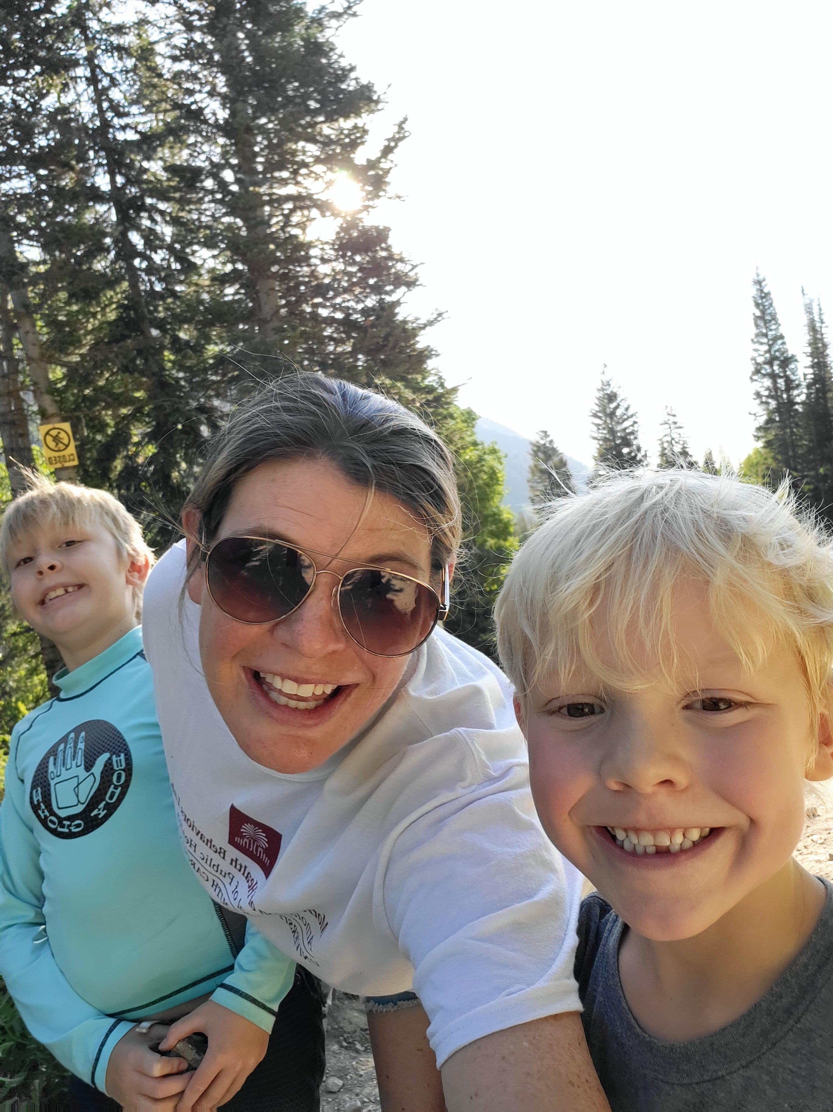
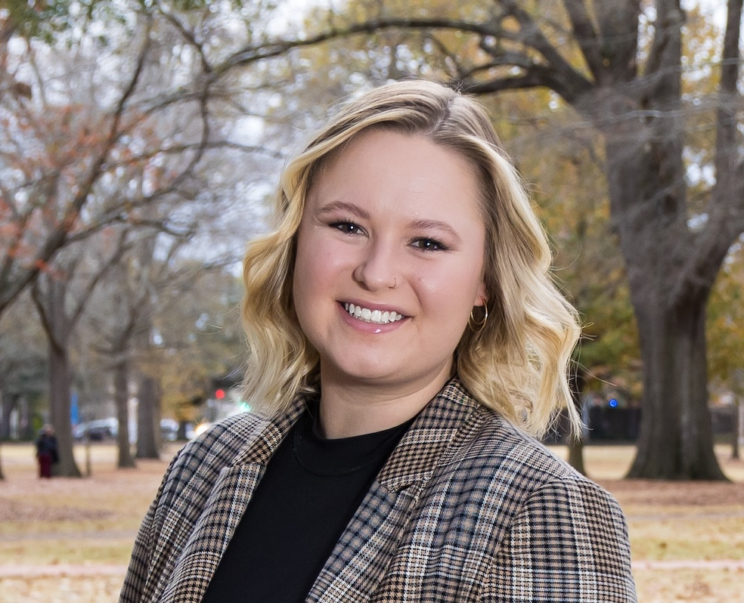
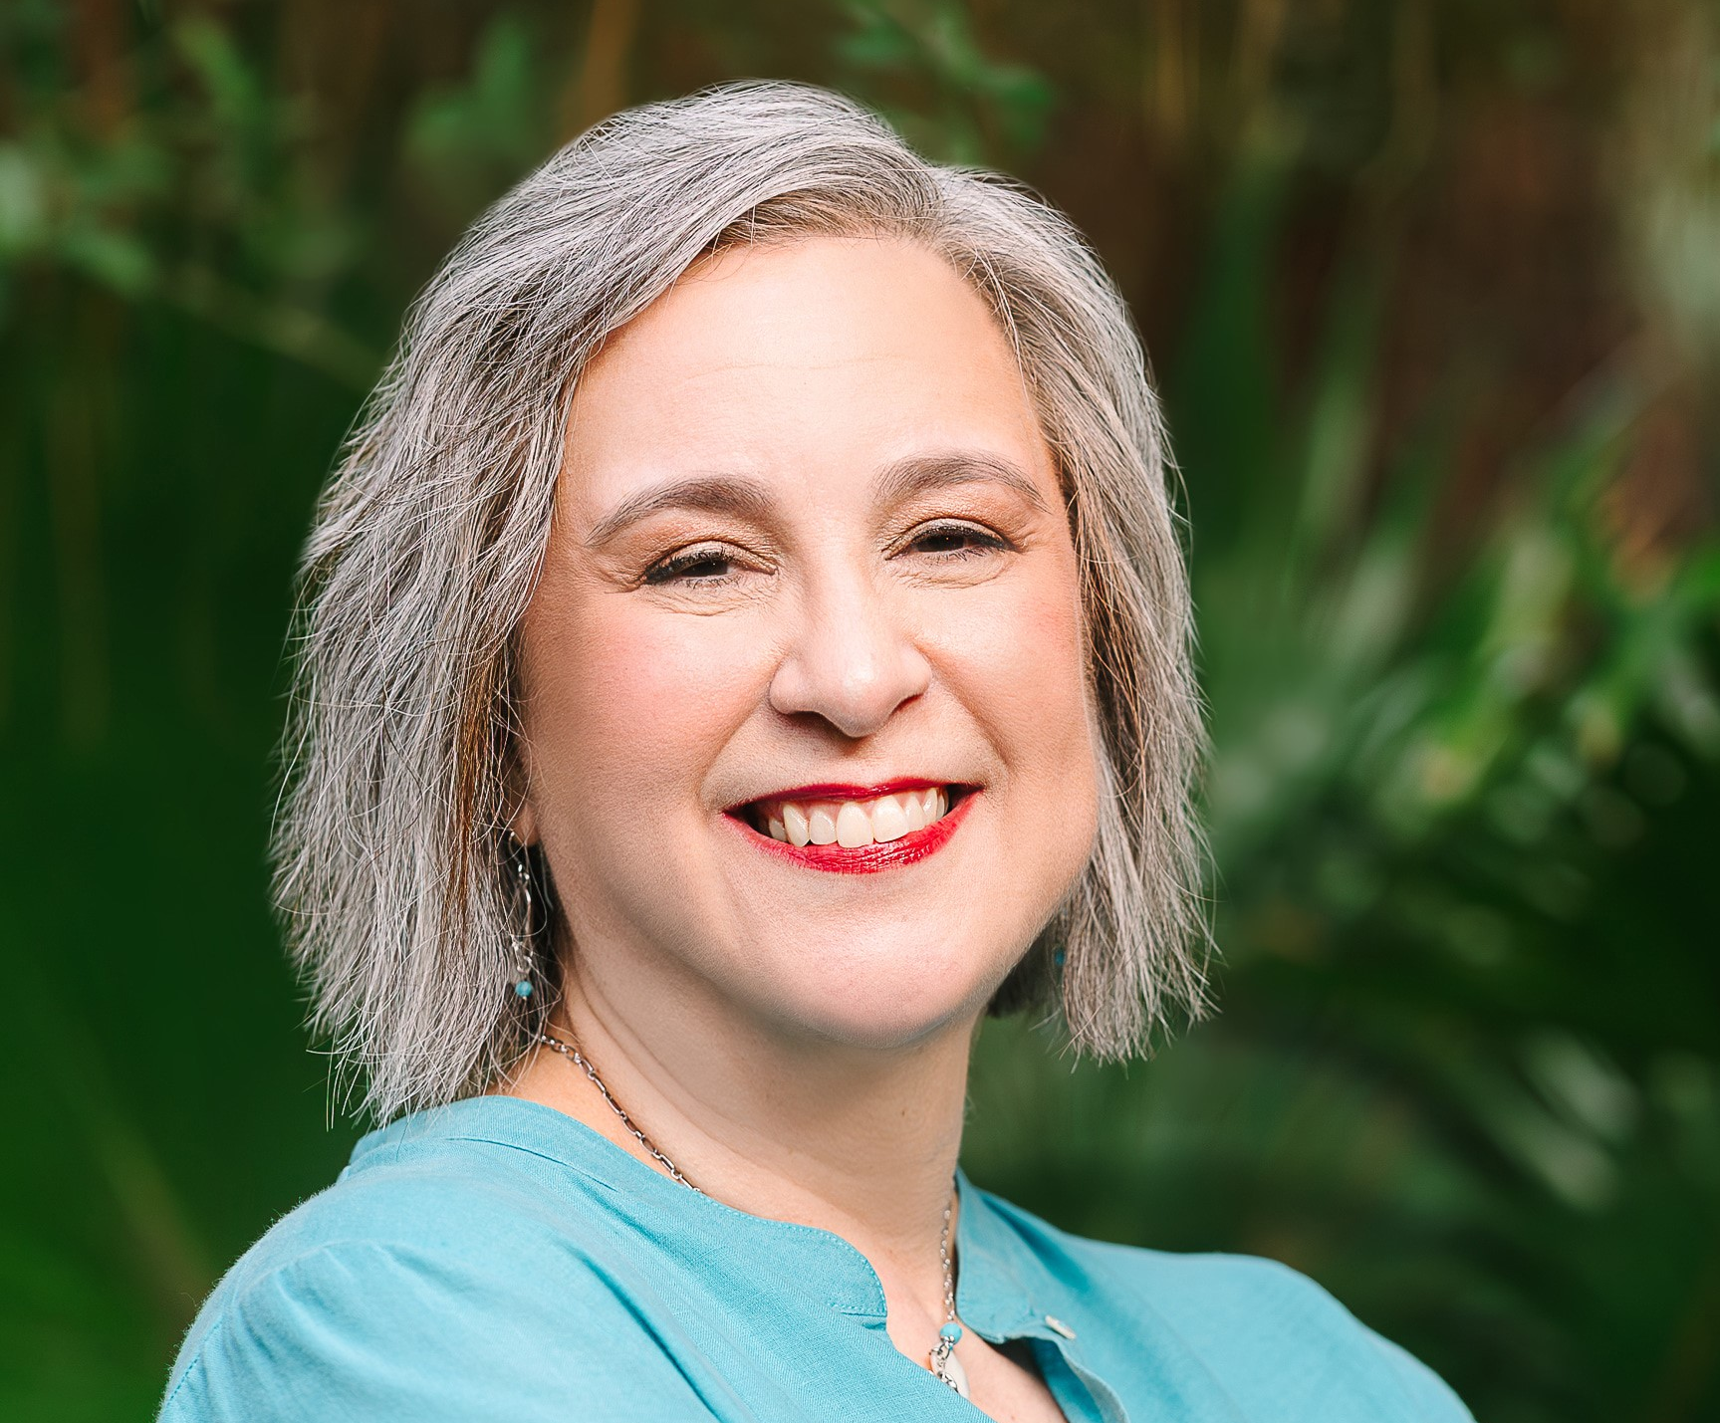
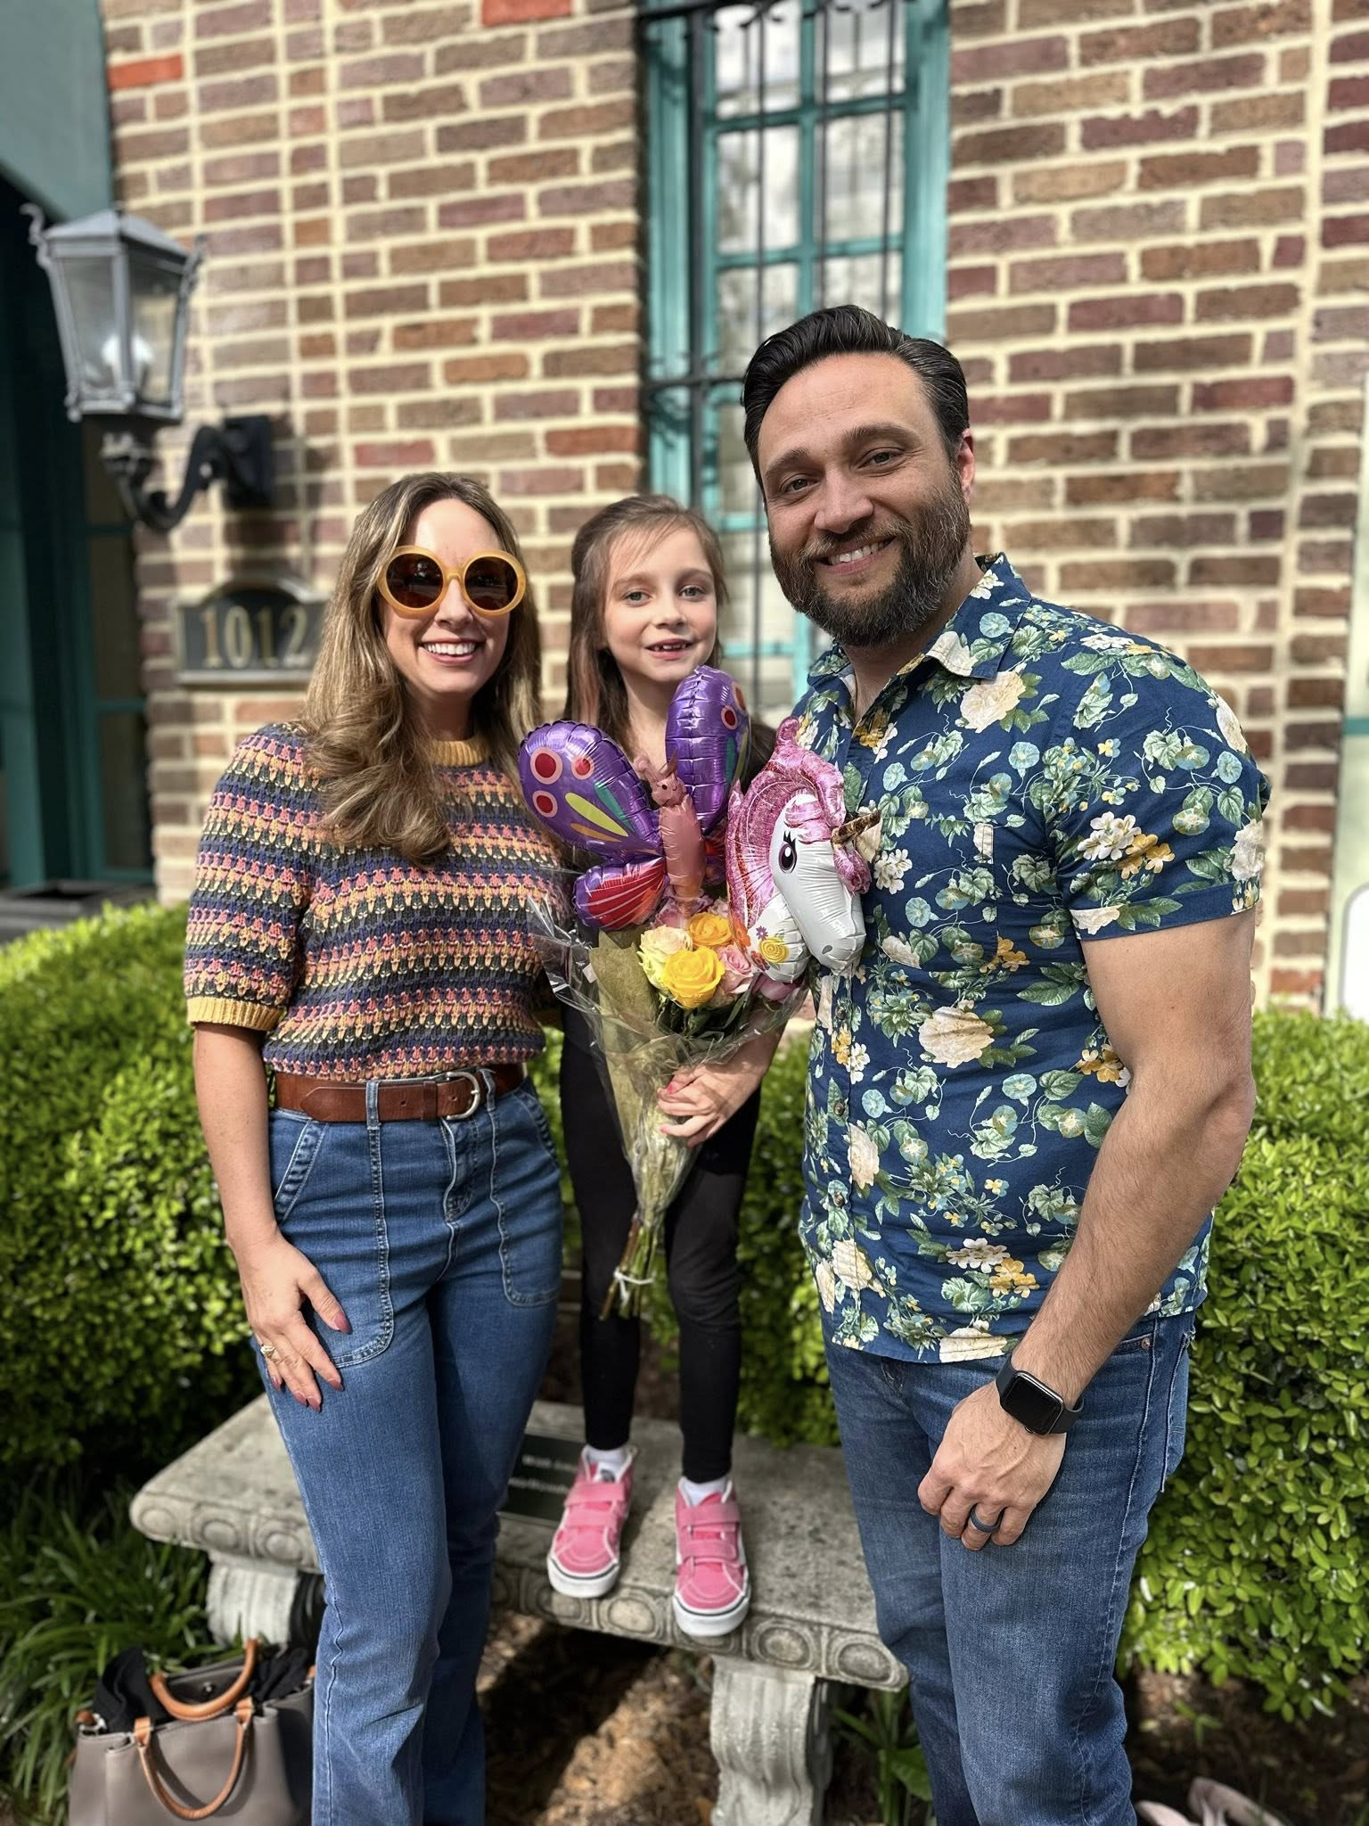
Introductions
Megan Austin-Cherry, PhD
Rachel Davis, PhD
Amanda Rebar, PhD
Nick Younginer, PhD

Slide 3
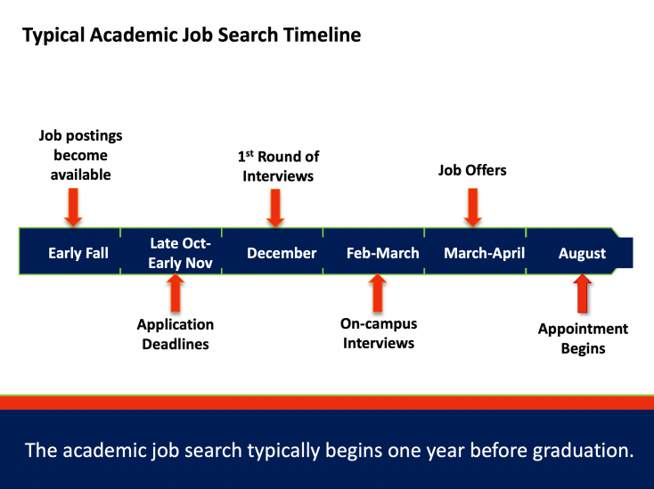
Understanding the timeline: academic
https://phdplus.virginia.edu/typical-job-search-timelines

Slide 4
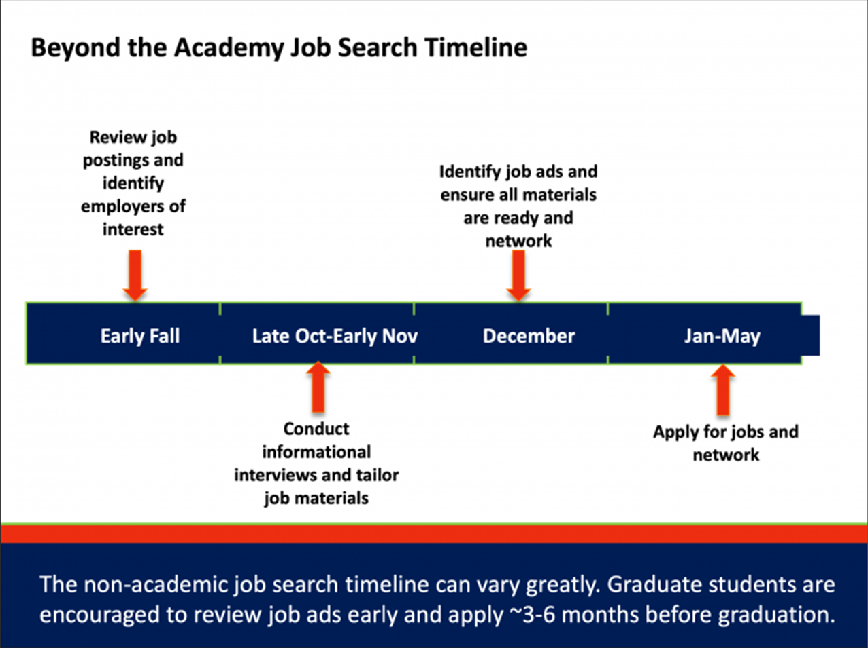
Understanding the timeline: non-academic
https://phdplus.virginia.edu/typical-job-search-timelines

Slide 5

Finding Academic Job Opportunities
Specific university sites
  Job postings
  Contacting faculty of interest
Websites listing opportunities in the U.S. and other countries:
  Academic Keys
  The Chronicle of Higher Education
  HigherEd Jobs
  AcademicCareers
  AcademicPositions
  PostdocJobs
ListServs and job boards for public health or interest-specific organizations
NIH RePORTER
ASPH and HPEB Department ListServs
Consider Academic/Professional Social Media (LinkedIn, X, Blueksky)

Slide 6
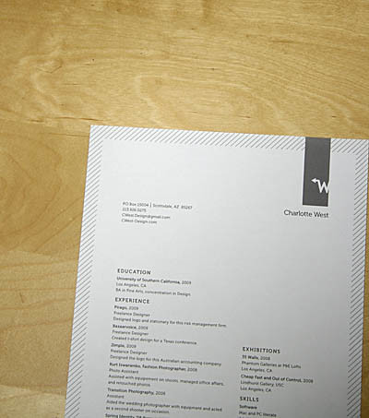

academic Cv
Clarify Your Target
Before writing: Do your research on who will be looking at this document and what they value for the position you are applying for (avoid generic documents)
  Academic CV: Focus on research, teaching, publications, grants, conferences, and service.
  Industry résumé: Emphasize skills, outcomes, and impact - not just papers. Show how your research solves problems.
Keep (at least) two versions ready: one detailed (academic), one concise (industry).
Find your < 3 key take aways
ThePhoto by PhotoAuthor is licensed under CCYYSA.

Slide 7
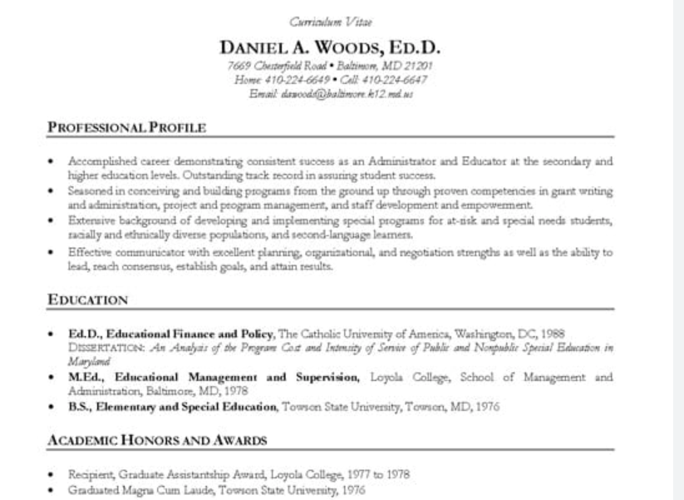
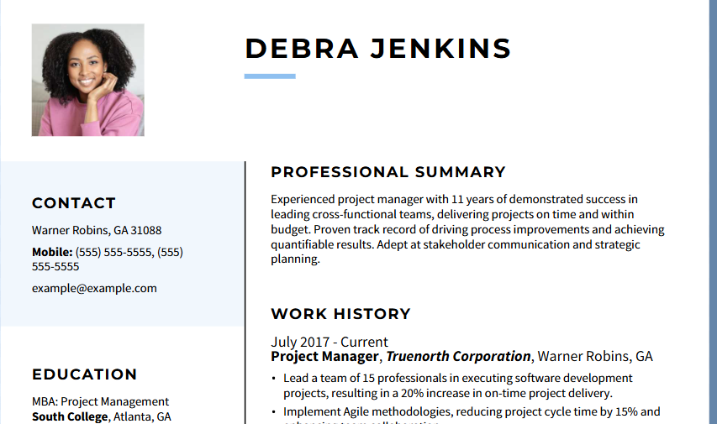
Formatting an academic Cv
Chronological Academic CV (Traditional)
Best for: Academics with a steady progression in research, teaching, and service.
Key feature: Lists education, positions, and publications in reverse chronological order (most recent first)
Modern Academic-Professional CV)
Best for: Roles that blend academia with industry, policy, or creative work.
Key feature: Combines a traditional academic CV structure with professional résumé elements like summaries or selected highlights

Slide 8
Formatting an academic Cv
Chronological Academic CV (Traditional)
Header: Name, contact info, affiliation, etc
Education: institutions, dates, thesis titles
Appointments: Positions, institutions, years
Publications: Books, journal articles, chapters, and conference papers
Teaching Experience: Courses taught, level, and institution
Grants and Fellowships: Name, funding body, and amount (if appropriate)
Awards and Honors
Service: Departmental, professional, or editorial roles
Modern Academic-Professional CV)
Header & Professional Summary: 2–3 sentences summarizing research focus and impact
Selected Highlights: Key publications, awards, top projects
Education
Academic Positions
Publications & Research
Applied/Industry Experience
Teaching & Mentoring
Service & Leadership
Grants & Fellowships
References

Slide 9
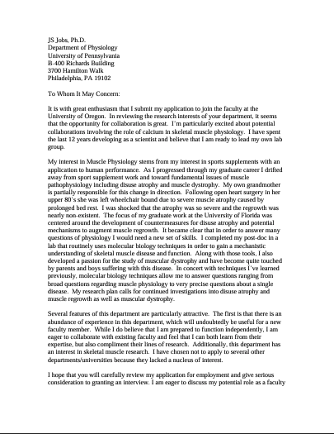
Developing A Cover Letter
Resources: University of Washington School of Public Health, HigherEd Jobs, The Chronicle, University of Pennsylvania Career Services
Dos
Don’ts
Keep it formal
Explicitly state the position you are interested in
Explain your qualifications, research experience, and teaching/mentoring experience
Lay out why this specific position or school/department interests you
Use this space to explain any inconsistencies
Harp on your weaknesses
Lie or exaggerate
Repeat exactly what is in your CV
Be the only set of eyes on your cover letter
Treat this as a personal statement (no emotional appeals)

Slide 10

Developing a Research Statement
What does a research statement look like?
  Written in prose with full paragraphs (not bullets)
  2-3 pages long, depending on experience
  Includes subheadings
  Organized overall by research topic and chronologically within sections
What are the goals of a research statement?
  Highlight research accomplishments and experience:
    Research topics, positions, funding, publications
  Show readers where you plan to take your research in the future:
    Plans to build on previous research findings and/or experiences
    Research questions you plan to address
    Specific plans to support your research (e.g., grant proposals you plan to submit and when)
  Demonstrate strong writing skills
Resources:
  University of Pennsylvania; Carnegie Mellon University; North Carolina State University; UCSF – includes examples of applications

Slide 11
Developing a teaching Statement
What does a research statement look like?​
  Written in prose with full paragraphs (not bullets) ​
  Around 1-3 pages long, depending on experience​
Institutional Culture
What are the goals of a research statement?
Provides a concise and concrete description of an instructor's teaching approach, methods, and experience
Teaching Statement
Experience
Methods
1. Experience
History of teaching
Course types and roles
2. Approach
Theoretical influences
Worldview
Authenticity
3. Methods
Application of approach
Specific examples
Approach
Resources
USC Center for Teaching Excellence
UNC Writing Center

Slide 12

Preparing for a Virtual Interview
What to expect:​
Usually 1-hour meeting
Often structured as:
  Interviewee giving brief overview of themselves
  Questions from interviewers
  Questions for interviewers
Often initial phase and first opportunity to present yourself
Keep in mind:​
Be authentic
It's about fit for both parties
Prepare for your interview:
Identify (if possible) who will be in the meeting and learn a bit about them beforehand
Take time to review the websites for the dept, school, university
Develop several questions to ask the interviewers related to expectations of the position, structure of the school, anything that you feel is important
Prepare a short presentation relating important information about you as a candidate
Ensure that you are in a comfortable, private place for the meeting-camera on
Consider setup and materials needed during the call- monitor placement, copies of your application materials? Notes for your presentation?

Slide 13
Preparing for an on-campus faculty interview
What to expect:
  1½ to 2 VERY full days: Don’t expect to have much down time
  The university will pay for your travel costs (keep receipts)
Travel day:
  Fly/drive in the night before your interview starts
  Someone from the school may pick you up from the airport: Don’t overdress; aim for dress casual clothing
  The school may schedule dinner with 1-3 people from the search committee or department
Day 1:
  Breakfast, lunch, and dinner with 1-3 people from the school
  Early meeting with search committee
  Give your job talk in the morning or afternoon: usually schools give you ~30 minutes of time to prepare before the talk
  Continual stream of 30-minute meetings with individual faculty and administrators (Chair, Dean, etc.) between meals and job talk
  Group meeting with students in the department on Day 1 or 2
Day 2:
  Breakfast and lunch with 1-3 people from the school
  Continual stream of 30-minute meetings with individual faculty and administrators between meals
  Meet with search committee toward end of visit
  Depart mid-day or mid-afternoon: Someone from the school may drive you to the airport

Slide 14

on-campus faculty interview, Cont’d
Meals:
  Usually scheduled to occur with 1-3 other people from the school
  Order food that is easy to eat, especially while talking
  Avoid or consume very limited alcohol (many schools will not reimburse their personnel for alcohol)
  Can be especially tricky times for managing personal information that you don’t want to reveal and provide opportunities for people to ask inappropriate questions
Physical preparation:
  Wear comfortable shoes and expect a lot of walking
  The school may or may not provide a place to store your belongings
  Ask the search committee chair for any needed accommodations (e.g., breast pumping, hearing loss)
  Try to be well-rested before you arrive
  Anticipate being physically and mentally exhausted (especially for introverts!)

Slide 15
on-campus faculty interview, Cont’d
Prepare your job talk:
  40-45 minutes for the talk, followed by 15-20 minutes answering audience questions
  Do NOT go over your allotted speaking time
  Focus on research for a research-focused, tenure-track position
  Job talk may require you to do a practice teaching demonstration for a teaching-focused position/school
  Practice, get feedback, anticipate audience questions
  Attend ASPH candidate job talks, pay attention to what you like or don’t like about those talks
Prepare for meetings:
  Create a list of questions you might be asked and your answers to those questions
  Obtain an itinerary that shows you will meet with
  Research the school, department, and each person you’re going to meet with, including search committee members
  Ask questions! Have questions ready for each person/group you’re going to meet with
Remember: The interview process is about finding a good fit, both from your perspective and the department, so you are also interviewing them
Decide what personal information you will vs. will not provide (e.g., presence of a spouse, children, disability, etc.): Know what people are legally allowed to ask you during a job interview
After you return home, send a thank-you email to the search committee chair (at a minimum) and each person you met with (not necessary but a nice touch if they met with you one-on-one)

Slide 16

Preparing for an on-campus postdoc interview
An on-campus interview may or may not occur for a postdoctoral fellowship
If you do have an on-campus postdoc interview, it will likely be a ½ or 1-day, diluted version of what was described for the on-campus faculty interview
Be curious
Demonstrate initiative and independence
Be honest about what you need and what you are looking for

Slide 17
Questions?

