Slide 1

Writing Workshop:
Let's Write a Manuscript!
February 22, 2023
Rachel Davis, Ph.D.
Courtney Monroe, Ph.D.
Emily Mann, Ph.D.

Slide 2
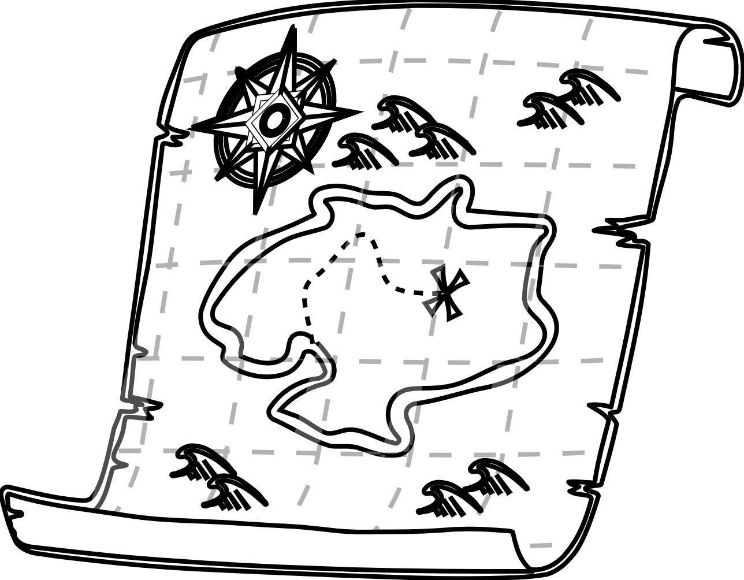
Today’s Presentation
Goal: To provide advice about and share strategies for writing scientific manuscripts.
We will touch on the following topics:
  What is a manuscript?
  Finding a manuscript idea
  Authorship
  Journal selection
  General scientific writing tips
  Norms to consider for different social science disciplines
  Quantitative-focused manuscripts
  Qualitative-focused manuscripts
  Your questions!
We will not cover these topics:
  Why write a manuscript
  Writing blocks
  Time management
  Group writing methods (e.g., paper chase)

Slide 3

disclaimer
We will share our personal opinions and experiences.
For many of these topics, there are no set ways of doing things.
We all have different expectations based on our own training and experiences.
We encourage you to seek out other people’s opinions and suggestions.

Slide 4

A manuscript is a story
At its core, a manuscript is a story.
Thinking of it as a story will hopefully help you to:
  Right-size the stress and amount of work needed
  Select a theme (topic)
  Gauge how long or short the story will be
  Identify the primary elements to include/exclude
  Think about your audience
  Choose an appropriate journal
  Focus on the chosen theme throughout the manuscript
  Ensure that the reader walks away with the key points
You don’t have to structure the manuscript the same way you structured the original idea/dissertation/grant proposal, etc.
Focus the manuscript story on what the most exciting findings were.

Slide 5
6 Types of manuscripts
Commentary or editorial:
  Shorter; usually written by experienced scientists who are leaders in the field; authors are often invited
Research brief or research note:
  Shorter; typically presents findings from a single, small experiment; not all journals publish these
White paper:
  Longer; typically describes conceptual thinking, theory development, and/or research experiences; may include limited data (e.g., anecdotal data) but does not focus on data analysis; harder to publish
Literature review:
  Longer; can be unstructured or highly structured (e.g., SCOPUS reviews have a specific methodology)
Meta-analysis:
  Longer; uses specific types of analyses to draw conclusions from findings across multiple studies
Empirical:
  Longer; most common format; focuses on presenting findings from analyses of qualitative or quantitative data; data may be drawn from primary or secondary sources

Slide 6
Finding a story idea
As you read papers that interest you:
  Write down questions that come to mind
  Pay attention to the discussion section (e.g., “additional research is needed on …”)
Ask your professors if they:
  Have manuscripts in mind or in progress that you can help with
  Have data that you can use to write a manuscript together
Look for available sources of data:
  Data you already have or could collect yourself
  Data provided through archives, such as The Inter-University Consortium for Political and Social Research (ICPSR), of which USC is a member
  Publicly available data sets (e.g., government-funded surveys)

Slide 7

A few warnings about Finding a story idea
Make sure that the data provide sufficient information for you to tell a good story (e.g., the key variables are present, the right kinds of participants were represented in the data set, interesting themes emerged, etc.).
The note above is especially true if you are using secondary data that was collected for a different purpose, as the limitations are sometimes too great to overcome to write a publishable manuscript (i.e., that reviewers will accept).
If you are early in your career, make sure that you are interested enough in the topic for it to have a starring role on your CV (e.g., pet therapy).

Slide 8
Start with your results
How do you know if you have a good story to tell?
1. Start thinking about your manuscript by drafting:
  Quantitative: The tables and/or figures to display your results, but do not write the results text
  Qualitative: The results text, including any accompanying tables or figures
  Note: Most journals limit the number of tables/figures you can include (often @ 5 total)
2. Look to see if you have enough interesting results to warrant a manuscript:
  Will the results be interesting and useful to other people who are not part of your study team?
  Do the results improve general knowledge or understanding about the topic?
3. If you have too many interesting results to adequately describe in one manuscript:
  Consider whether the results can be grouped into more than one distinct story
  If you have more than one distinct story, think about sharing the results in separate manuscripts
  Note: Avoid salami publishing, which is an ethical transgression!

Slide 9
Start with your results
4. Share your draft (tables and figures/result text) with co-authors:
  Ask for input on the quality of the story (e.g., is it too much? Is the focus on the right outcome?)
  Solicit feedback on the presentation of the results (e.g., is the presentation clear?)
5. If you have a good story, proceed to write the rest of the manuscript.
Note: The steps recommended above assume that you are familiar with your topic. For quantitative work, draft the introduction and methods sections before you do the data analyses if you don’t know much about your topic. This will help you to learn about the extant literature, shape the hypotheses/questions you pursue, and make decisions about how you conduct the analyses.

Slide 10

Authorship rules
The first author is generally the person who wrote the manuscript.
If the first author is a mentee (e.g., student, postdoctoral fellow), the mentor is generally listed as the second author or the last author.
Other authors are listed in the order of the extent of their contributions to the manuscript.
Requests for assistance with manuscript development should be commensurate with each person’s anticipated authorship order.
Journals are increasingly asking authors to describe the role each author had in developing a manuscript to justify authorship.

Slide 11
Authorship rules, cont’D
Authorship rules vary across and within disciplines.
In some social science fields, scientists are encouraged to publish as much as possible as a single author or with only 1 co-author.
In health promotion, it is common to include:
  Multiple authors
  The Principal Investigator for the original study during which the data were collected as a senior author (e.g., last author), even if they have a minor role in developing the manuscript
  All Co-Investigators for the original study during which the data were collected as co-authors for main outcome manuscripts (e.g., findings that address specific aims) but to exclude them as authors for secondary outcome manuscripts if their involvement is limited
  Anyone who had a sufficiently large role in data collection or study design as a co-author, even if they have a minor role in developing the manuscript (this does not apply to paid data collectors, such as professional interviewers or survey companies)
  Collaborators from data collection sites and/or community partners as co-authors

Slide 12

Negotiating authorship
Have direct, clear communication about authorship.
Decide who will be the first author before starting the work.
Ask your mentor who needs to be included as a co-author.
Decide the order of other co-authors at the end of manuscript development, after you know the levels of their contributions.

Slide 13
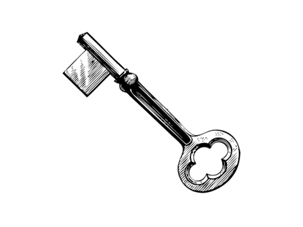
Choosing a journal
Identify a journal or set of target journals as early in the writing process as possible.
Different journals:
  Have different word limits
  Include different things in the word limits (e.g., tables, references)
  Include/exclude different types of content
  Publish different manuscript formats
  Have different expectations for writing style and content, e.g.:
    Including an in-depth theoretical background
    Stating hypotheses (vs. leaving them implied)
    Expecting brief introductions with a standard number of paragraphs
    Requiring bullets listing implications for health promotion practice

Slide 14
Choosing a journal, CONT’d
Look at the journals included in the references you cite.
Ask your co-authors for suggestions.
If you have a draft of the abstract, you can use a journal finder (most publishers have their own versions).
Once you have some ideas, look at potential journals’ websites to:
  Make sure the journal is peer-reviewed
  Look up the journal’s impact factor (it may be easier to find this on other sites)
  Read about the journal’s aims and scope to assess content fit
  Look at a sample of published papers to assess content fit and writing style
  Review the guidelines for authors
  Find out if the journal requires you to share your data and/or your software code (e.g., SAS code)
  Know what, if any, fees will be charged to authors

Slide 15

Tips for scientific writing
Tips based on common challenges and mistakes

Slide 16
Manuscript title and abstract
Manuscript title:
  Choose a manuscript title that accurately reflects what the story focus will be
Abstract:
  Write an abstract that will entice readers to want to know more – make it interesting!
  Keep the background and methods sections specific and brief
  Include a line at the end of the conclusion that states the most interesting, important takeaway message(s) from your manuscript (do not say “more research is needed”, as that is almost always true!)

Slide 17
introduction
Pose a strong rationale for why your study needed to be done – saying that no research has been done on your topic is important but is not a sufficient rationale for doing a study.
Pay attention to whether the journal expects a particular format or content (e.g., stating hypotheses, providing a theoretical model).
If there is insufficient theory or literature about the topic, describe your study as exploratory.
Don’t mention every relevant study that exists – just enough to support your arguments.
Be explicit in showing your thinking about how constructs may be related (e.g., don’t just say “xx is related to yy” without describing how this might happen conceptually).
Don’t use language that comes across as biased (e.g., “the goal of this paper is to prove that xx is true”).
Clearly state the goals of the study described in the manuscript at the end of the introduction.

Slide 18
Use a Synthesized Writing Style
When you are summarizing findings from previous literature (usually in the introduction and discussion), use a synthesized writing style.
Synthesized writing = You (the author) summarize findings from other studies and convey to the reader what the implications of those findings are for the current work.
Do not describe a series of studies in separate sentences and paragraphs, as this approach asks the reader to do the work of synthesizing, which they likely won’t do, since this is your job as the writer.

Slide 19
Example of Non-Synthesized Text
Smith (2017) conducted a study of 216 Aboriginal children in Australia in which the children were tracked from aged 3 through 45. During that time, he found that children who were overweight at age three were more likely to be overweight at age 45 than children who were at a healthy weight at age three. In another study, researchers looked at medical records from 1,100 children in New York City (Puffwaffen & Stiles, 2010). They tracked variables such as height, weight, age, and cognitive function. Then, they looked later to see if weight at age three predicted adult weight. They found … Similarly, Arabella and DesLimoges (2001) found ... Etc.

Slide 20
Example of Synthesized Text
Childhood obesity tracks through adulthood (Smith, 2017; Puffwaffen & Stiles, 2010) and is associated with increased risk of cancer incidence (Jones, Oswego, & Ruiz, 2008) and mortality (Arabella & DesLimoges, 2001; Ravenside, Winklebottom, Noodle, Tourniquet, & Snuggles, 2005). Many behaviors associated with pediatric obesity develop in early childhood (Tarken et al., 2011; Orkin & Nolls, 2003); thus, interventions for preschool-aged children may be optimal to prevent obesity and reduce long-term disease risk.

Slide 21

BUILD paragraph sandwiches
Paragraph sandwiches make it easier for the reader follow your main arguments.
Structure each paragraph in your introduction and discussion in this order:
  Main point (e.g., “Research is needed to identify how to effectively teach students about writing”)
  Evidence, evidence, evidence (e.g., make arguments to support your main point with supporting evidence by citing existing studies in the literature)
  Summarize what the evidence indicates re: your study in a concluding main point

Slide 22
Methods, Results, and Discussion
Methods:
  Be clear and specific about the methods used
  Pay attention to how your target journal expects the methods section to be structured (e.g., in some fields, sample characteristics are described in the participants section, while in other fields sample characteristics are presented in the results section)
  When describing measures, start with your primary outcomes (dependent variables), followed by the independent variables, and, lastly, control variables (typically sociodemographics)
Results:
  Just describe what you found – any commentary about the findings should be in the discussion, not here
  Don’t duplicate all of your findings in the text and in the tables/figures
Discussion:
  Do not overstate your findings
  Do not present findings that were not included in the results section
  Be specific when referring to findings among your sample vs. all people from that social group
  Contextualize your findings within the preexisting literature (e.g., are your findings similar or different from what other studies have observed?)

Slide 23
Citing and referencing
Use peer-reviewed sources.
Read any original sources you plan to cite.
Use appropriate citing, referencing, and paraphrasing techniques to avoid plagiarism.
You CAN self-plagiarize: Published works are copyrighted by the publishers.
If you refer to other studies or other researchers, cite examples to support your claim (e.g.,“Many researchers have proposed that … [need citations of those researchers]”).
Put the citations exactly where they belong – especially in a list:
  Ex: “Writing can make people happy (cite studies that show evidence of this part of the sentence), but only when they enjoy the topic (cite studies that show evidence of this part of the sentence) and feel that they have adequate time to get it done (cite studies that show evidence of this part of the sentence)”
When saying something controversial, include citations to support your statements.
Use referencing software to start building your reference library.

Slide 24

Have a consistent story flow
The story you are telling should logically flow from section to section:
  Introduction → Methods → Results → Discussion
Use the same order of ideas within each section:
  Ex: If you have 2 main outcomes, A and B, discuss Outcome A first and Outcome B second within every section of the manuscript
Make sure the results and discussion answer the hypotheses/questions you posed in your introduction.
Everything in the manuscript should contribute to the story.
If something is not pertinent to the story, leave it out!

Slide 25

General scientific writing tips
Be clear and specific:
  Ex: Instead of “other populations,” say which populations
  Ex: Instead of “related to”, describe how the entities or concepts are related
  Ex: Instead of “multiple factors,” say which factors
Use social science research methods terminology.
Don’t make sweeping generalizations:
  Ex: Results of studies indicate and suggest things, they don’t “prove” or “show” them
  Ex: Avoid language that suggests that all people in any group (or subgroup) do, feel, or think the same way
Write so that an MPH-trained reader can understand what you’re saying (but provide details about your analyses and results for those with more training).
If comparing one social group to another, be sure to say what the comparison group is.
Know whether the journal does/does not allow or encourage use of the first person.
Practice defensive writing: Think about what a manuscript reviewer might criticize/ask.

Slide 26
General grammar and writing tips
Put a comma before “which” (e.g., “The study found xx, which suggests …”).
Do not put a comma before “that” (e.g., “suggests that everyone can write well”).
Include a hyphen between two words that are working together to form an adverb or adjective (e.g., “Mandarin-speaking participants …”).
But, if an adjective or adverb ends in “-ly,” do not put a hyphen after it (e.g., write “rapidly evolving situation” and not “rapidly-evolving situation”).
Proofread and proofread again before asking other people to review your writing.
Prioritize writing time when you are focused, not distracted, rested, and have a chunk of time – writing is hard mental work.
Do other things when you are tired/distracted (e.g., find articles to read, fix references).
Leave each writing session at an easy place to pick up again at the next session (e.g., write a note to yourself in the document like “Describe barriers to writing in the next paragraph”).

Slide 27
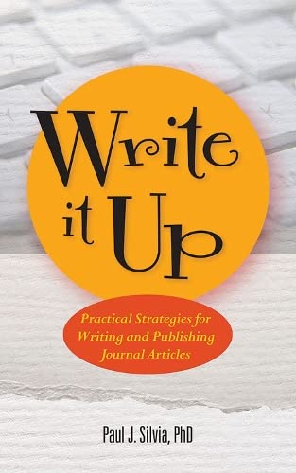


Slide 28
Tips for quantitative manuscripts
Courtney Monroe, Ph.D.
Assistant Professor

Slide 29
Quantitative manuscript Tips
→Find quality article(s) in the same realm(s) you can use as model(s)
→Know the literature and gaps
→Introduction
Have a BLAST (frame the Big problem; address relevant Literature; reveal what is Absent in previous studies; describe your Study purpose and Testable hypotheses when relevant): Fallon M. Writing Quantitative Empirical Manuscripts with Rigor and Flair (Yes, It’s Possible). Psi Chi J Psychol Research. 2018;23(3):2325-7342)
*Stick to the heart of the specific aspect(s) your study addresses
→Methods
*Balance providing sufficient detail for replication with space requirements

Slide 30
Quantitative manuscript Tips
→Results
*Plan ahead – if analyses require sophisticated statistics you cannot do on your own
*Figures and tables crafted in such a way that they could stand on their own
*Report 95% confidence intervals when relevant
→Discussion
*Address primary findings right away
*Do not rehash the findings in a way that makes it feel like the Results section is being repeated
*Be thoughtful and creative – interweave previous findings for comparison, your own logical explanations, ideas for future research throughout
*So what? What are the practical implications (sometimes its own section)

Slide 31
Tips for quaLitative manuscripts
Emily S. Mann, Ph.D.
Associate Professor

Slide 32
Writing QuaLitative Manuscripts
Start with Results
  What you anticipate the contribution to be will clarify how you intended to use theory and the extant literature to inform your approach to writing the manuscript.
  Ask yourself: Is my analysis more descriptive or interpretive? Does my approach to analysis aim to advance theory? What gap in the literature am I attempting to fill and why?
Identify a Journal
  Manuscripts using qualitative methods tend to be lengthier so ensure your journal choice has a sufficient word count maximum for your contribution.
Develop the Introduction and Background Sections
  Depending on the type of journal and your intended contribution, you may or may not need a developed background section in addition to the introduction.
Results and Discussion vs. Integrated Findings and Conclusion
  Depending on the journal, you can take different approaches to writing up your study findings.

Slide 33

Find what works for you
Every person is unique - find what works for you.
Examples of strategies that work for some people:
  Writing simultaneously with a writing partner, virtually or in person
  Writing alone
  Creating an outline before starting to write (most people find this helpful)
  Free writing (e.g., writing down your stream of consciousness with your thinking about your topic without worrying about writing or grammar, to expand your thinking before attempting to write polished text)
Don’t force yourself to use strategies that aren’t working for you (even from a well-meaning mentor!).

Slide 34
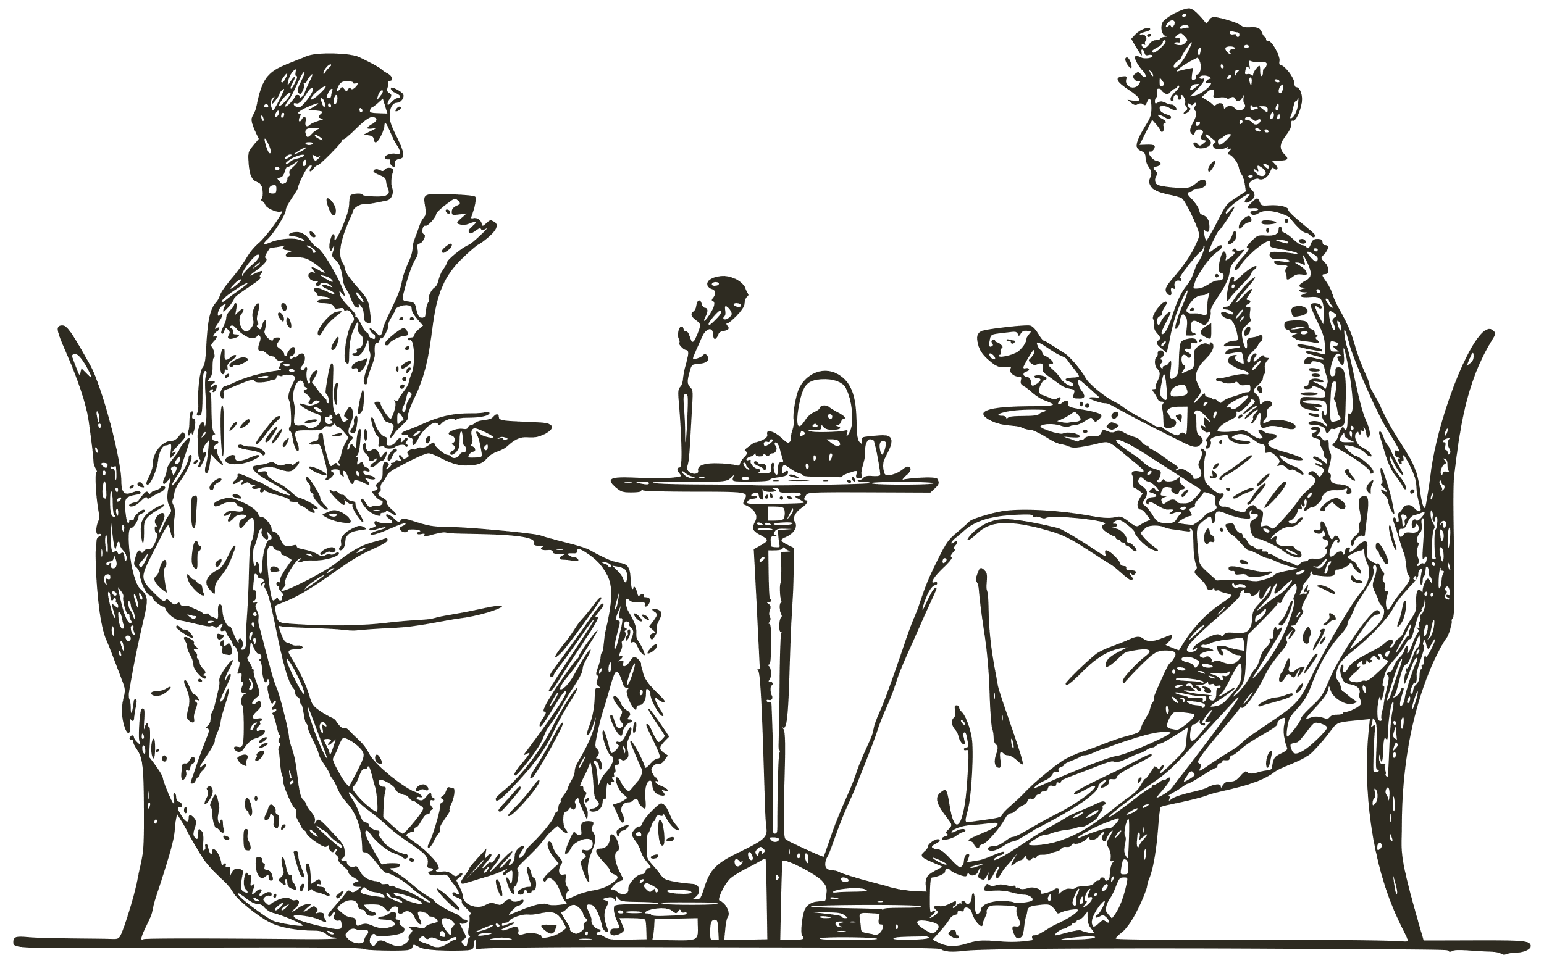
Questions?

