Slide 1

Writing Workshop:
Let's Write a Manuscript! PART 2
March 14, 2024
Marta Bornstein, Ph.D.
Rachel Davis, Ph.D.
Courtney Monroe, Ph.D.

Slide 2
Today
Brief recap of session 1 (slides are available on the HPEB website)
Considerations for selecting a journal
Preparing to submit a manuscript
What to expect during the peer review process
Responding to reviewers
General writing tips
Manuscript tips for different types of data
  Quantitative, qualitative, and mixed methods
Additional resources

Slide 3
Recap of session 1
Six types of manuscripts:
Commentary/editorial
Research brief/ research note
White paper
Literature review
Meta-analysis
Empirical/ original research

Slide 4
Recap of session 1
A manuscript is a story:
  Generate idea(s) - reading articles in your field, talking with professors about their work, and looking at available sources of data
  Start with results – table shells (quantitative), theme outlines (qualitative); assess what you have and if it is sufficient; discuss with collaborators
Authorship guidelines
Scientific writing tips for each section
Norms in publishing
You can find the PowerPoint slides online the HPEB website!

Slide 5
Recap of session 1: Types of data
The study design and type of data you have will guide how you write your manuscript.
No matter the type of data, writing organization and clarity are critical.
Read examples of different kinds of manuscripts to see how they describe their methods, report results, and craft introduction and discussion sections.
Original research studies are typically:
  Quantitative
  Qualitative
  Mixed methods

Slide 6
Selecting a journal

Slide 7
Why is it important to select a quality journal?
Establishes the credibility of your research
Enhances your reputation as a researcher
Ensures your research reaches the intended audience and has the maximum impact

Slide 8
What makes a quality journal?
Criteria | How to assess
Scientific rigor | Read recent publications, paying particular attention to methods sections Check if journal requires using existing reporting guidelines and/or clinical trial registration
Editorial quality | Read recent publications, paying attention to grammatical errors, clarity of writing, and formatting
Peer review process | Should describe review process transparently, including types of review, timeline, confidentiality, and conflicts of interest
Ethics | Journal should have clear guidelines about research ethics, including requiring the study went through ethical review (IRB)
Editorial board members | Editorial board members should be experts in areas related to the journal's aims and scope
Journal reputation | Reputable journals are often (but not always) sponsored by or associated with organizations (e.g., APA, APHA, AMA, etc.) Business model, including any publication fees, should be clearly described
Indexing status | Reputable journals index articles in databased that make your work easy to find Journals should index in MEDLINE, PubMed, etc.
Impact factor | Impact factor is a metric that is calculated based on number of times articles are cited The formula can vary, but the goal is to assess the reach and impact of articles published in that journal
Journal operations | Journals should assign a digital identifier (DOI) or international standard serial number (ISSN) to all articles
Suiter & Sarli (2019). Selecting a Journal for Publication: Criteria to Consider. https://www.ncbi.nlm.nih.gov/pmc/articles/PMC6913840/

Slide 9
Think, check, submit
Think | Are you submitting to a trusted journal?
 | Is the journal right for your work?
Check | Do you/your colleagues know this journal?
 | Is the publisher of the journal easy to identify on the website? Is there contact information?
 | Is the journal transparent about the type of peer review it uses?
 | Are articles indexed to make them easy to find?
 | Are publication fees (if any) clear?
 | Are there specific author guidelines on the website?
 | Is the publisher a member of COPE (committee on publication ethics) or other relevant initiative (e.g., DOAJ for open access journals)?
Submit | If the answers are yes – go ahead!
For a complete checklist, visit: https://thinkchecksubmit.org/journals/

Slide 10
Journal impact factor
"The impact factor (IF) is a measure of the frequency with which the average article in a journal has been cited in a particular year. It is used to measure the importance or rank of a journal by calculating the times its articles are cited." (https://researchguides.uic.edu/if/impact)
There are multiple tools journals use to calculate and report their IF. You may hear IF called CiteScore, SCImago Journal Rank, or SNIP. They are all slightly different calculations meant to measure the same thing – impact!
Beware:
The impact factor should not be your sole consideration when choosing a journal.
Newer journals and journals that cater to specific or smaller subfields will typically have lower impact factors.
Some journals (e.g., PLOS journals) do not publish an impact factor.

Slide 11
Practical tips for assessing fit
Now you know how to identify quality journals, but how do you assess if the journal is the right fit for your research?
  Which journals publish the articles you read/cite?
  Which journals are your colleagues/mentors publishing in?
Disqualify a journal for your manuscript if:
The journal explicitly states it does not publish the type of research, location of research, etc.
  Don't submit an article to a journal that only publishes US based research if your work took place in South America
The journal rarely or never published work using the method you used (e.g., qualitative, mixed methods)
  Don't submit a qualitative paper to a journal that only publishes quantitative studies
The journal has a survey response rate or sample size requirement that you do not meet
  Don't submit a manuscript based on a study with a 30% response rate if the journal requires 50%

Slide 12
Tips for choosing a journal
  Ask your colleagues for their experiences with specific journals
  Editor review time – a quick desk reject can be a gift!
  Peer review time
  Some people have journal horror stories, while others had a good experience – so ask a few people!
Publication fees
  Some reputable journals charge publication fees, particularly for open access
  Make sure you know the publication fee in advance and how you will pay for it (e.g., grant funding for dissemination)
  Don't submit to a journal that charges a fee without knowing exactly how that fee will be covered
  Funder requirements: some funders require you to publish in open access journals (and they will typically pay for it or include dissemination in the budget)
  The NIH typically requires articles to be open access after a journal specific embargo period (and journals won't typically charge authors to meet that requirement)

Slide 13
Additional considerations for assessing fit
Word count limits
Number of tables and figures permitted
Required sections/contents of sections
  E.g., some journals require a more detailed literature review in the introduction, a separate theory section, a public health impact section, etc.

Slide 14
Resources for choosing a journal
There are online resources available to help you find a good fit for your manuscript.
SJR: https://www.scimagojr.com/
  Look up journals to find their impact factor, rank in specific subfields, and similar journals
  Can also help you assess journal credibility.
JANE: https://jane.biosemantics.org/
  Paste in your abstract or manuscript text and it finds journals that have published similar articles.

Slide 15
When should you choose a journal?
This can vary, but typically early in the writing process
Figuring out the manuscript 'story' and choosing its journal home will happen in tandem
Journal requirements will inform how you write the manuscript, but, to some degree, how you (want) to write the manuscript – or how it needs to be written to convey your findings – should dictate the journal you choose.
Try to select a first-choice journal and 1-2 journals you will submit to if you get a rejection (it helps if the journals all have somewhat similar word counts!)
Reassess your journal choice throughout and at the end of the writing process

Slide 16
Preparing to submit your manuscript
Getting everything ready to submit and actually submitting can be a tedious process
You will need to pay attention to details
Set aside half a day to submit your manuscript

Slide 17
Preparing to submit
Once you have chosen a journal, written the manuscript, and have coauthor approval it is time to submit!
Review and re-review the author guidelines on the journal website (typically under guide for authors')
  Know that these will often feel unclear and contradictory!
Make final changes to formatting, citations, etc. to meet the journal requirements
  If you don't, they will probably send it back to you, extending the review time
  Using 'I' and 'we' can often be journal dependent, so edit as needed
De-identify the manuscript
  Take author names off the first page
  Replace "this study was approved by the IRB at University of South Carolina" with "this study was approved by the IRB at [blinded for review]"
  If applicable, remove other information that could be identifying

Slide 18
PREPARING TO SUBMIT
Create an account to submit using the journal's online system
Depending on journal guidelines, you will likely need to:
    Create a separate title page (title of paper and author names)
    Submit a separate abstract (adhering to a specific word count, usually 200-350 words)
    Select ~5 key words from a pre-existing list that will help categorize and identify your manuscript
    Provide author and co-author information
        Name, degrees, department, university/institution, email, address, phone number (sometimes)
        Make sure to ask your co-authors what information to provide if you are unsure
    You may need the funder name and grant numbers

Slide 19
PREPARING TO SUBMIT​
  Prepare separate documents:
    Title page (with authors names)​
    Main text (de-identified)​
    Table x (sometimes each table needs to be saved as its own document)​
    Figure x (sometimes each figure needs to be saved as its own document)​
    Funding statement (sometimes can be included in main text)​
    Acknowledgments (optional; sometimes can be included in the main text)​
    Appendices (if any)

Slide 20
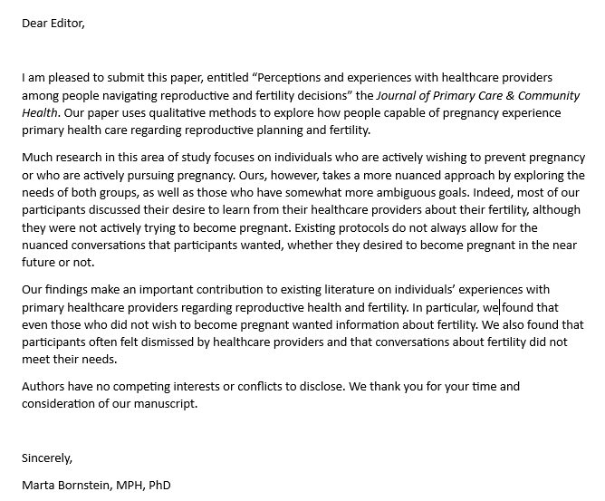
Cover letter
Write a cover letter
The cover letter is a brief formal letter that introduces your submission. Typically, it should address:
  The manuscript title and brief description
  How your findings contributes to or expands the field of research
    How your findings, methods, etc. are distinct from previous research
    How your manuscript fits with the journal aims (key words)
  Brief description of your most interesting finding(s)
  A note about conflicts of interest or ethical adherence

Slide 21
Expectations during peer review process
  Don't have any (just kidding...kind of)
    Process and possible outcomes
      Desk reject // revisions after peer review // reject after peer review
    What are they reviewing?
    Timing
      Varies (may have to check in with them)

Slide 22
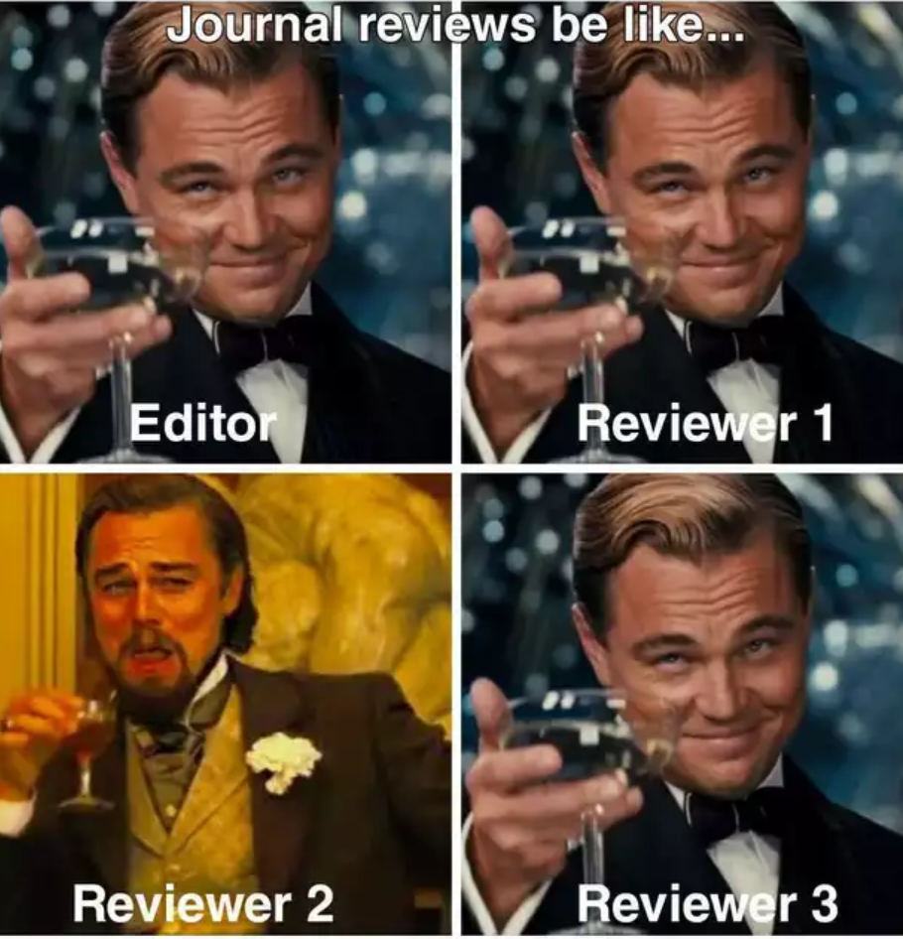
Expectations during peer review process
  Responding to reviewers
    Read and take some time before responding if needed
    Consider organizing comments
    Seek examples/mentorship
    Discuss with co-authors
    Be polite and professional

Slide 23
Example response
REVIEWER: Title: The authors should consider revising the title. It is currently long and a bit awkward to read. One suggestion: "Harnessing technology and gamification to increase adult physical activity: A cluster randomized controlled trial of The Columbia Moves pilot"
MY RESPONSE: Thank you for the suggestion. We have changed the title to “Harnessing technology and gamification to increase adult physical activity: A cluster randomized controlled trial of The Columbia Moves pilot" (p. 1, lines 3-4)

Slide 24
Example response
REVIEWER: Lines 205-206. It is not clear how step progression goals were set, e.g., was this a standardized progression or customized to the individual somehow?
MY RESPONSE: This step goal was based on evidence which shows that accumulating 3,000 steps in 30 minutes beyond habitual activity levels is approximately equivalent to at least 30 minutes of moderate-intensity walking in adults, based on a cadence of 100 steps per minute.¹ It is easy for participants to understand and track while still approximating the recommended guidelines, and thus, it can be used as a meaningful heuristic physical activity goal.¹ Aiming for an average of 1,000 steps/d above one’s personal average daily baseline step count during the first intervention week and 2,000 steps/d above one’s personal average daily baseline step count during the second intervention week before aiming to achieve 3,000 steps/d or more above one’s personal average daily baseline step count during the third intervention week and beyond reflects an incremental progression to help mitigate injury risk, while also building self-efficacy to be physically active.^{2,3} Setting the goal in relation to one’s own average daily baseline step count helped personalize it as indicated in the original version of the manuscript (“…personal average daily baseline step count”). We have used this step goal in a previous study.⁴ We added this sentence to better communicate the rationale for this goal: “This daily step goal reflects an incremental progression towards 3,000 steps/d which approximates the recommended PA guidelines [76].” (p. 8, lines 216-217).

Slide 25
Example response
REVIEWER: What is the employment status of the study participants (Do they work)? Type of work may affect social networks and physical activity.
MY RESPONSE: You raise a good point. For example, employment status and type of work may affect the time individuals in social networks have to interact with one another around physical activity, as well as their own levels of occupational and leisure-time physical activity which may have important health ramifications¹ and influences on PA of other members in their social network among other considerations. Employment status and type of work may also interact with other factors to influence physical activity among team members. We did not ask participants about their employment status, so we are not able to explore that aspect. Further, it was beyond the scope of this paper to examine...factors
However, we agree that it would be interesting to examine these factors, including employment status in future studies, so we integrated the following content into an existing statement in the Discussion section: “Future PA promotion research should experimentally seek to determine...(pp. 23 and 24, lines 565-569).

Slide 26

General scientific writing tips
Be clear and specific:
  Ex: Instead of “other populations,” say which populations
  Ex: Instead of “related to”, describe how the entities or concepts are related
  Ex: Instead of “multiple factors,” say which factors
Use social science research methods terminology.
Don’t make sweeping generalizations:
  Ex: Results of studies indicate and suggest things, they don’t “prove” or “show” them
  Ex: Avoid language that suggests that all people in any group (or subgroup) do, feel, or think the same way
Write so that an MPH-trained reader can understand what you’re saying (but provide details about your analyses and results for those with more training).
If comparing one social group to another, be sure to say what the comparison group is.
Know whether the journal does/does not allow or encourage use of the first person.
Practice defensive writing: Think about what a manuscript reviewer might criticize/ask.

Slide 27
General grammar and writing tips
Put a comma before “which” (e.g., “The study found xx, which suggests …”).
Do not put a comma before “that” (e.g., “suggests that everyone can write well”).
Include a hyphen between two words that are working together to form an adverb or adjective (e.g., “Mandarin-speaking participants …”).
But, if an adjective or adverb ends in “-ly,” do not put a hyphen after it (e.g., write “rapidly evolving situation” and not “rapidly-evolving situation”).
Proofread and proofread again before asking other people to review your writing.
Prioritize writing time when you are focused, not distracted, rested, and have a chunk of time – writing is hard mental work.
Do other things when you are tired/distracted (e.g., find articles to read, fix references).
Leave each writing session at an easy place to pick up again at the next session (e.g., write a note to yourself in the document like “Describe barriers to writing in the next paragraph”).

Slide 28



Slide 29
Manuscript tips
Discussion
Address primary findings right away
Do not simply rehash the findings – this is your chance to interpret and explain
Situate your findings within the existing literature (articles that found both similar and different results are relevant)
  Be thoughtful and creative – interweave previous findings for comparison, your own logical explanations, ideas for future research throughout
Strengths/limitations (sometimes its own section)
So what? What are the practical implications (sometimes its own section)
Introduction - Have a BLAST:
Frame the Big problem
Address relevant Literature
Reveal what is Absent in previous studies
Describe your Study purpose and Testable hypotheses (when relevant):
  Fallon M. Writing Quantitative Empirical Manuscripts with Rigor and Flair (Yes, It’s Possible). Psi Chi J Psychol Research. 2018;23(3):2325-7342)
Methods and findings/results are more specific to type of manuscripts/data (see next slides!)​

Slide 30
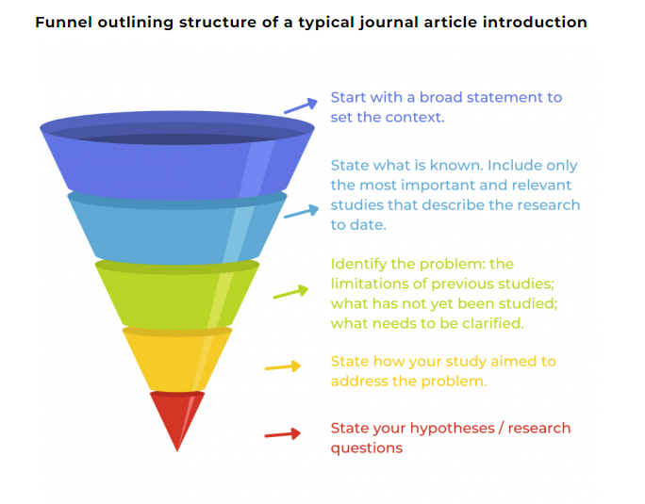
Funnel approach
The introduction funnel:
general/broad ---> specific
The discussion should be the opposite:
specific findings ---> broader implications
https://asiaedit.com/blog/3-fundamental-principles-of-writing-an-effective-introduction-to-your-journal-article

Slide 31
Quantitative manuscript tips
Types of data – e.g., surveys
Methods – be specific:
Describe dataset (cite original study)
Describe key variables (dependent variable(s), independent variable(s), covariates)
  Can include the survey item and how you coded it/recoded it
  If you recoded it say how and why (e.g., recoded 'don't know' as missing)
Describe your analytic sample (start with stating the total sample size and then the exclusions, missing data, imputations that led to your analytic sample)
  A figure can sometimes be helpful here if it is complex
Be detailed in describing how you analyzed the data
  State analytic methods and justify them (e.g., we used a negative binomial regression model to account for over dispersion)
Describe any sensitivity or additional analyses
Results:
Use sub-sections to organize your findings, often by stage of analysis (e.g., bivariate statistics, multivariate statistics) or by outcome variable
Make tables clear and follow journal guidelines on decimal points, reporting of confidence intervals or p-values, etc.
Tables should stand alone, meaning they should include all the information you need to interpret them within the table titles, table itself, and footnotes
Avoid just repeating the exact information from the tables into the text
Avoid interpretation or extrapolation of results within the results section

Slide 32
Qualitative manuscript tips
Types of data – e.g., interviews, focus groups
Methods – be specific:
Justify the method(s) you chose
Discuss how you collected the data and who collected it (reflexivity)
Discuss if/how you decided to stratify data
Note how you decided when to stop collecting data
Be detailed in describing how you analyzed the data
Make sure to use terms to describe your study design and analysis (coding) methods that are recognizable to qualitative experts
Cite sources (this will help if you have a reviewer that does not know much about qualitative research)
Results:
Use sub-sections to organize your findings (often by theme)
Include quotations that support your statements
Make quotations more readable by using brackets and ellipses
Include counter-cases when appropriate ("most participants agreed that X, but some said Y“)
Include tables of quotes only if necessary and useful
Avoid quantifying qualitative data
Avoid too much interpretation or extrapolation of results within the results section – like with quantitative data, this should go in the discussion.

Slide 33
Mixed methods manuscript tips
Types of data – any combination of quantitative and qualitative
Methods – Tips for Quant and Qual both apply, but with mixed methods there are more considerations:
Justify the method(s) you chose – why was mixed methods the best option for your research question(s)
  You typically don’t have to get into this in quantitative manuscripts – people assume if you analyze survey data that a survey was the 'right' method
Justify the study design – how did one phase/type of data inform the other? What order was data collection, or was it simultaneous? Why?
Use terms that mixed methods researchers will recognize
Cite sources (this will help if you have a reviewer that does not know much about mixed methods research)
Discuss how you analyzed the different types of data, both separately and together, and in what order
Results:
Think hard about the best way to organize your results
Is it better to describe qualitative results then quantitative? The opposite? Or is it best to integrate the qual and quant results by theme
  Read a lot of examples of how people do this
Use sub-sections to organize your findings (by theme and by data type)
Like in qualitative, include quotations that support your statements
How do the different methods "talk" to each other to form your results? Call out contradictions ("interview participants said X, but survey results point to Y")

Slide 34

Questions?

