Slide 1
Grad fellowships 101: Health promotion, education, and behavior
National Fellowships
Matt Klopfenstein

Slide 2
EXTERNAL FELLOWSHIPS AND GRANTS
Finding Funding
Select Opportunities
How We Can Help
Graduate Fellowship Advising

Slide 3
graduate funding basics
Basic terminology:
  Internal funding
    Funding that comes from within the University of South Carolina
      Examples: SPARC, Presidential Fellows, departmental awards
  External funding
    Funding from a source outside of the University of South Carolina
  Fellowship
    Funding that supports you (tuition, research, stipend, etc.)
  Grant
    Funding that supports a specific project (research)
  Scholarship
    Funding for specific education-related expenses (tuition, fees, books, etc.)

Slide 4
Where to find graduate funding
Pivot
  https://pivot.proquest.com/
University of Illinois Fellowship Finder
  https://apps.grad.illinois.edu/fellowship-finder/
UCLA GRAPES
  https://grad.ucla.edu/funding/#/
Zintellect
  https://www.zintellect.com/Catalog
Professional associations and listservs

Slide 5
how to find graduate funding
Note: Available opportunities can vary significantly for students, even within the same program
Factors to consider:
  Program type
    Significantly more funding at PhD level
  Thematic/subject focus
    Specialization? Particular populations?
  Methodology
    Quantitative or qualitative? Mixed methods? Human subjects?
  Location for research
    Many national-level exchange programs and regionally-focused professional associations
  Citizenship and identity/background
    National, ethnic, racial, gender, socioeconomic
  Time frame
    Plan a year ahead

Slide 6



Know your funder
Each funder has a distinct mission/priorities
Larger mission
  Basic research? Societal outcomes?
Research priorities
  Interdisciplinary? Theoretical? Policy relevant?
  Particular theme?
Specific criteria
Previous recipients

Slide 7
Opportunities in public health/hpeb
Categories of possible types of funding*:
Health-focused opportunities
Social science opportunities
Applicant-specific opportunities
*There may be other options depending on your research/goals/background

Slide 8
Health-focused opportunities
Graduate Fellowship Advising

Slide 9
Nih national research service awards
F series grants (F30, F31, F31 Diversity)
  Training awards for researchers in health-related fields
  Up to 5 years of support
    Annual stipend of $28,224 plus 60% of tuition and allowance for training expenses (includes insurance)
  Apply to specific institute or center
    NIH RePORTER
  Must be U.S. citizen, national, or permanent resident
  Multipart application
    Requires input from advisor, department, and SAM
  Deadlines: April 8, August 8, December 8

Slide 10

AHA Predoctoral Fellowship
American Heart Association Predoctoral Fellowship
  Supports mentored training for doctoral students who intend careers as scientists, physician-scientists or other clinician-scientists, or related careers aimed at improving global cardiovascular, cerebrovascular and brain health
Up to 2 years of support
  Annual stipend of $28,224 plus insurance and research support
  Open to international students
  Deadline: Expected September 2025

Slide 11


Global health opportunities
Multiple international opportunities for U.S. citizen doctoral students through NIH, Fulbright, and Boren:
Global Health Program for Fellows and Scholars
  NIH Fogarty International Center
  Programs through participating consortium institutions conducting research in low- and middle-income countries
  Note: some international students may be eligible for postdoctoral awards
Fulbright-Fogarty Fellowships in Public Health
  Participate in NIH-funded research work in select countries
Fulbright U.S. Student Program
  Conduct independent research in more than 140 countries
Boren Fellowship
  Study a less-commonly taught language in a priority country
  Can combine with graduate research
  Pathway to federal employment

Slide 12

Health policy research scholars
Health Policy Research Scholars
  Leadership development program for doctoral students interested in health policy
  4 year award that provides $30,000 annually
    Policy and leadership trainings
  Must apply as a first-year doctoral student
  Applicants must be U.S. citizens/permanent residents from marginalized or historically underrepresented populations
    First-generation, socioeconomic status, race, disability, etc.
  Deadline: Expected March 2025

Slide 13

Internship/professional opportunities
CDC Fellowships
  Find these and similar opportunities in Zintellect
  Some are open to international students
  Some opportunities open to master’s students
NIH Summer Internship Program
  Paid summer internships with NIH researchers
  Open to master’s students
  Deadline: February 2025
    Opens mid-November
    Advantageous to apply during first three weeks of cycle

Slide 14
Social science opportunities
Graduate Fellowship Advising

Slide 15

Russell sage foundation dissertation research grants
Russell Sage Foundation Dissertation Research Grants
  Up to $10,000 for a one-year grant
    Up to $5,000 may be for stipend
  Must relate to foundation’s goal to “to improve social and living conditions in the U.S.” in the following areas:
    Behavioral Science and Decision Making in Context
    Future of Work
    Race, Ethnicity, and Immigration
    Immigration and Immigrant Integration
    Social, Political, and Economic Inequality
  Open to international students
  Deadline: February 1, 2025

Slide 16
Horowitz foundation for social policy grants
Horowitz Foundation for Social Policy Grants
  $10,000 awards to support research on “contemporary issues in the social sciences”
    Social policy application
  Must have defended proposal by deadline
  Open to international students
  Deadline: December 1

Slide 17

Spencer dissertation fellowship
NAEd/Spencer Dissertation Fellowship
  For research on education and learning in any discipline
    Multidisciplinary review panel
  Provides $27,500 stipend
    Two professional development retreats
  Must complete dissertation in one or two years
  Ten-page proposal, personal statement, workplan
  Open to international students
  Deadline: October 3

Slide 18
Applicant-specific opportunities
Graduate Fellowship Advising

Slide 19

Aauw fellowships
AAUW American Fellowship (Dissertation)
  For scholars in any PhD program who identify as women
    Must be a U.S. citizen
  For final year of dissertation writing Provides $25,000 stipend
  Deadline: November 15
AAUW International Fellowship
  For scholars in any graduate program (masters, professional, doctoral) who identify as women
    Must NOT be a U.S. citizen
    Must plan to return to passport country to pursue a career
  $20,000 (master’s/professional) or $25,000 (doctoral) stipend
  Deadline: November 15

Slide 20

Graduate women in science fellowships
GWIS National Fellowship Program
  Research grants of up to $10,000
  Open to women who are members of GWIS
  Supports hypothesis-driven research
  Open to international students
  Deadline: Expected January 2025

Slide 21

Southern regional education board
SREB Awards
Seeks to increase number of underrepresented minority students pursuing faculty careers
  Doctoral Award: three to five years of support
    $20,000 stipend plus tuition
    Must apply within first year
  Dissertation Award: one year writing award
    $20,000 stipend plus tuition
    Must be ABD to apply
Must be U.S. citizen and have South Carolina in-state residency status
Due March 31, 2025

Slide 22
Support from national fellowships
Graduate Fellowship Advising

Slide 23
Resources for graduate students
The National Fellowships office is here to help you identify and apply for external funding
We help you with:
Finding external funding opportunities
Personal advising and feedback on fellowship proposals
Resources on proposal writing
Connections to peers and faculty with relevant experience
  Graduate Fellowship Peer Mentors

Slide 24
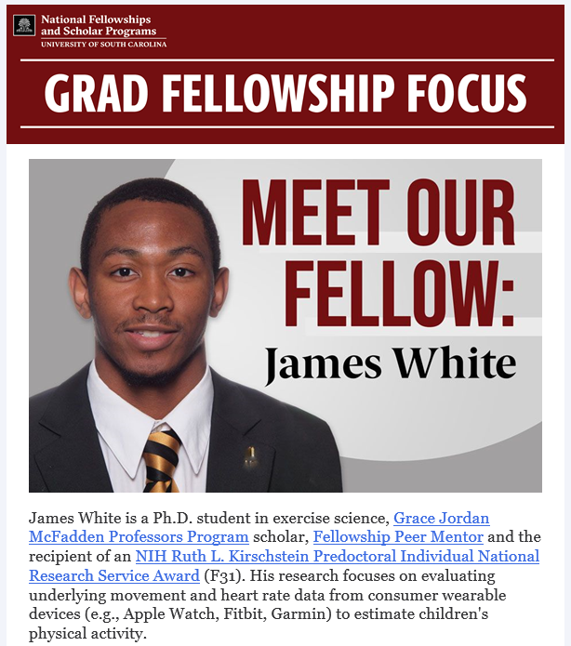
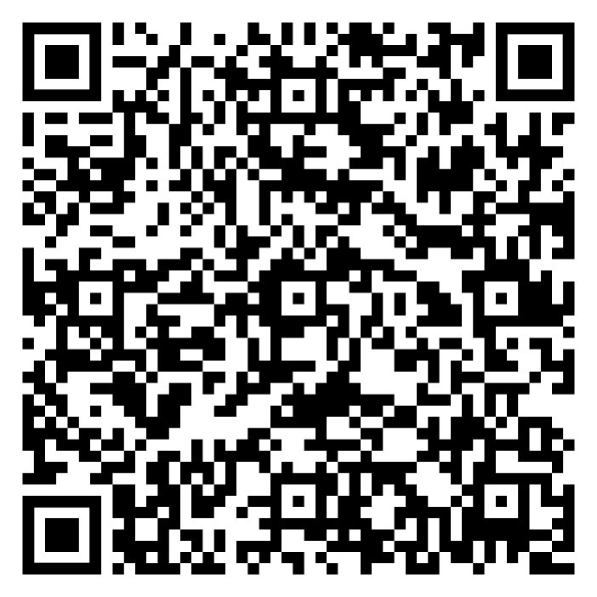
Fellowships newsletter
Sign up to get regular updates on:
Upcoming opportunities and deadlines
Workshops and info sessions
Current USC winners

Slide 25
Get in touch
Matt Klopfenstein, PhD, National Fellowships Coordinator for Graduate Students
klopfenm@mailbox.sc.edu
Schedule a one-on-one advising appointment (virtual or in-person) at www.calendly.com/gradfellowships
Visit our website
sc.edu/nfsp
Stop by the Grad Hub (Close-Hipp 204)

Slide 26
Questions?
Graduate Fellowship Advising

